Slide 1

Data Warehouses
Lecture # 1
Topic : Introduction to Data Warehousing
Prepared by: Eng. Basem Khalaf
Semster-1 , Level-3
Fall 2023

Slide 2
Agenda
Introduction
Historical Perspective - Inmon and Kimball
ETL and ELT Concepts
Staging Area Concept
Data lake and Data warehouse Differences
Data Warehousing Types
OLAP vs OLTAP

Slide 3
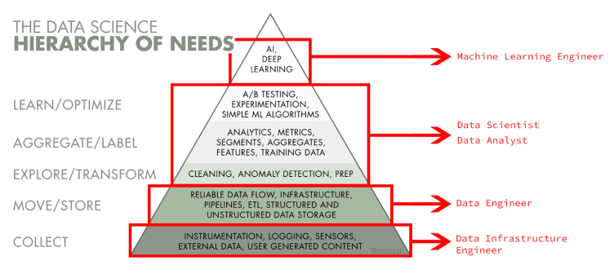
Introduction

Slide 4
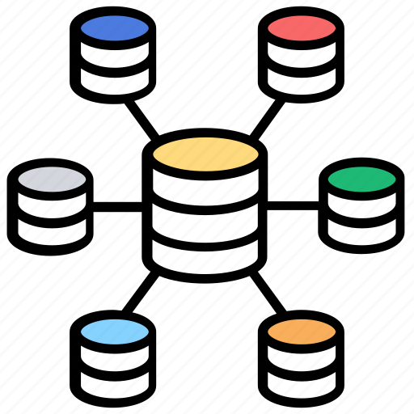
Introduction
Data Warehousing
is a centralized repository that stores, manages, and consolidates data from various sources within an organization. It is designed to support business intelligence (BI) activities, reporting, and data analysis.

Slide 5
Historical Perspective - Inmon and Kimball
1. Bill Inmon - The Father of Data Warehousing
Bill Inmon, often referred to as "The Father of Data Warehousing," played a pivotal role in shaping the concept and practices of data warehousing.
In the 1980s, Inmon introduced the idea of the "Corporate Information Factory" (CIF), which laid the foundation for modern data warehousing. The CIF concept emphasized the centralization of data into a single, integrated repository.
Inmon's approach focused on creating a normalized data model, known as the "Enterprise Data Warehouse (EDW)." This EDW served as the core repository for all data within an organization, ensuring data consistency and accuracy.
His methodology advocated for data integration through Extract, Transform, Load (ETL) processes, making it possible to gather data from disparate sources and load it into the EDW.

Slide 6
Historical Perspective - Inmon and Kimball
2. Ralph Kimball - The Dimensional Modeling Pioneer
Ralph Kimball is renowned for his pioneering work in dimensional modeling, which is a key component of data warehousing.
In the 1990s, Kimball introduced the concept of the "Data Warehouse Bus Architecture." Unlike Inmon's approach, Kimball's methodology focused on creating data marts, which are smaller, subject-specific data warehouses derived from the central data warehouse.
Kimball's dimensional modeling emphasized the use of fact tables and dimension tables, which simplified data retrieval and analysis. This approach made it easier for business users to understand and navigate data.
His methodology promoted the use of star schemas and snowflake schemas, which are optimized for query performance and user-friendliness.

Slide 7
Historical Perspective - Inmon and Kimball
3. Contributions and Ongoing Debate
Both Inmon and Kimball made significant contributions to the field of data warehousing, but their approaches differed in key aspects. Inmon favored a highly normalized approach, while Kimball promoted a dimensional, denormalized approach.
The debate between Inmon's and Kimball's methodologies, often referred to as the "Inmon vs. Kimball" debate, has been ongoing for years. It highlights the importance of choosing the right approach based on the specific needs and goals of an organization.
In practice, organizations may adopt elements from both methodologies, combining centralized data warehousing with dimensional modeling to create a customized solution that suits their unique requirements.

Slide 8
Introduction
Challenges of Traditional Data Management
Data Fragmentation: In traditional setups, data is often scattered across various systems, departments, and formats, creating data silos.
Limited Historical Data: Operational databases, known as OLTP systems, are designed for transaction processing. They typically store a limited history of data, making it challenging to perform historical trend analysis and long-term forecasting.
Inefficient Reporting: Generating meaningful reports from multiple, disconnected data sources is time-consuming and error-prone.
Resource-Intensive Queries: Analyzing data from operational databases can overload these systems, leading to slower performance and potentially disrupting day-to-day operations.
Lack of Integration: Integrating data from different sources and formats is complex and often requires custom scripts or manual efforts.

Slide 9
Introduction
Importance of Data Warehousing
Data Integration: Unifies diverse data sources, revealing insights across departments.
Historical Analysis: Provides a long-term view for trend analysis and informed decision-making.
Enhanced BI: Empowers data-driven decisions through robust reporting and BI tools.
Efficient Queries: Optimized for quick, complex data analysis without affecting transactional systems.

Slide 10
Introduction
Importance of Data Warehousing
Competitive Edge: Enables agility, responsiveness, and innovation for a competitive advantage.
Compliance & Governance: Ensures data accuracy, consistency, and security, crucial in regulated industries.
Scalability: Adapts to growing data needs, suitable for startups to large enterprises.
Cost Savings: Reduces storage costs, streamlines data management, and minimizes duplication.
Data-Driven Culture: Cultivates a culture of empirical decision-making, transforming business operations.

Slide 11

ELT and ETL Concpets
Staging Area
Data lake and Data warehouse Differences

Slide 12
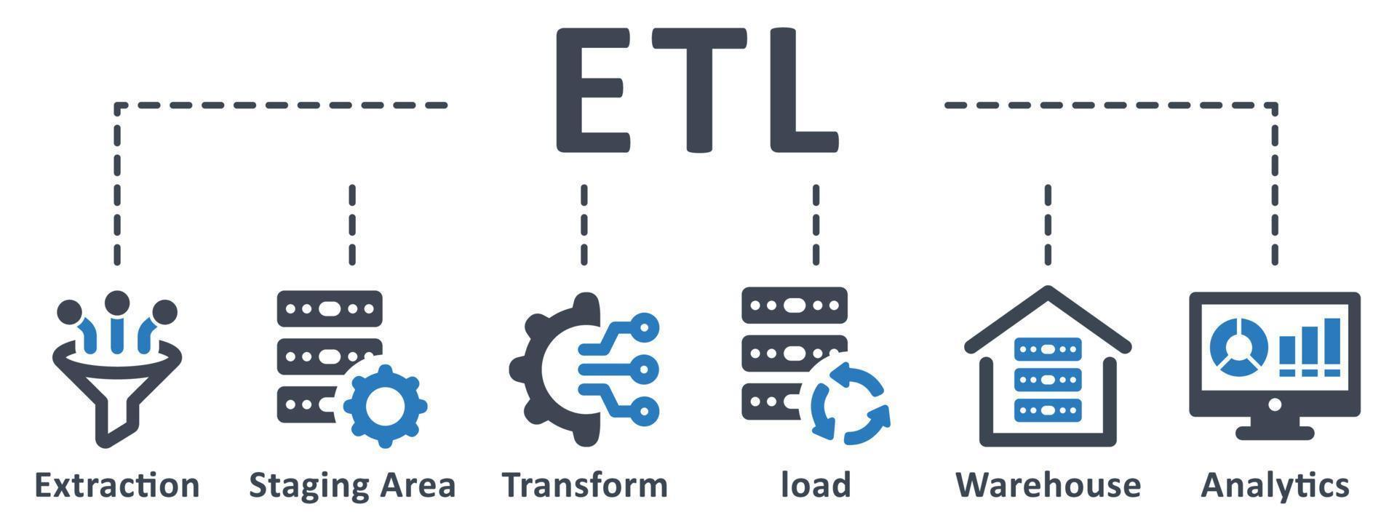
ETL and ELT Concepts
ETL (Extract, Transform, Load):
Extract: In the ETL process, data is first extracted from various source systems such as databases, files, or APIs.
Transform: After extraction, the data undergoes a transformation phase where it is cleaned, filtered, and manipulated to meet the specific requirements of the target data warehouse or analytics system. This may involve data cleansing, aggregation, data type conversion, and other transformations.
Load: Finally, the transformed data is loaded into the target data warehouse or repository, where it can be accessed and analyzed by business intelligence tools, reporting systems, or data analysts.
ETL is often batch-oriented and tends to be used for structured data.

Slide 13
ETL and ELT Concepts
ELT (Extract, Load, Transform):
Extract: Similar to ETL, data is initially extracted from source systems.
Load: In ELT, the data is first loaded into the target storage or data warehouse without significant transformation. It's stored in its raw or semi-structured form.
Transform: Transformation occurs after the data is loaded into the target system. Users can then perform transformations, data cleaning, and modeling using the processing power and tools available within the target system, often a data warehouse like Snowflake or Google BigQuery. ELT is more suitable for handling unstructured or semi-structured data and is commonly used in modern data warehousing architectures.

Slide 14
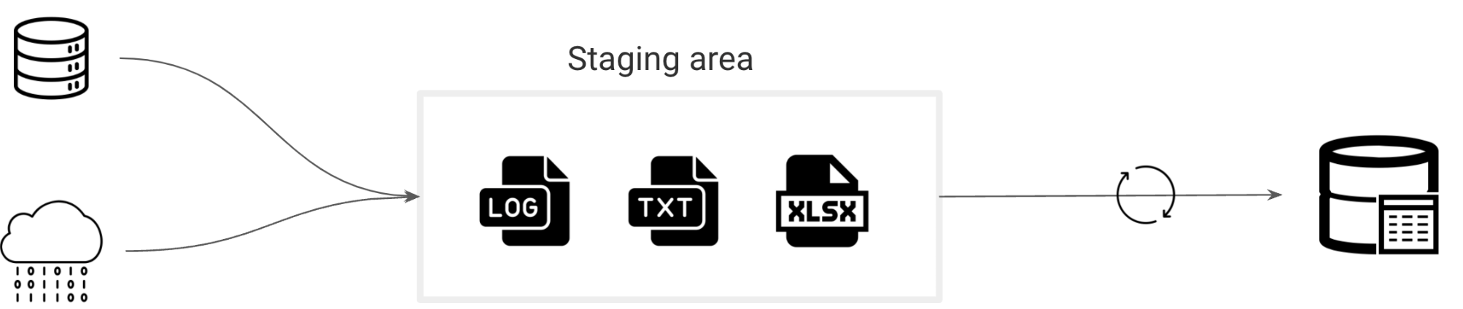
Staging Area Concept
A staging area in data engineering:
is a temporary storage area where raw or unprocessed data from various sources is initially loaded and stored before it undergoes further processing, cleansing, and transformation.
It serves as a buffer between source systems and the data warehouse or analytics platform, allowing data engineers to validate, clean, and prepare the data for analysis without affecting the performance or integrity of the target system.
Staging areas are crucial for data quality control and ensuring that only reliable and well-structured data enters the final storage or analytical environment.

Slide 15
Data lake and Data warehouse Differences
Data Lake:
Suitable for storing raw, diverse data types.
Schema-on-read for flexibility.
Supports batch and real-time processing.
Ideal for big data and exploratory analysis.
Cost-effective for large unprocessed data.
Data Warehouse:
Designed for structured data with predefined schemas.
Schema-on-write for data optimization.
Optimized for batch processing and reporting.
Ideal for business intelligence and structured data analysis.
Typically higher cost due to data structuring.
Key Difference:
Data Lake is best for diverse, raw data, while Data Warehouse is for structured data, with both often used together to meet various data storage and analysis needs.

Slide 16
OLAP vs OLTP
OLTP )Online Transaction Processing(
Primary purpose: Efficiently manage and process day-to-day transactional data.
Characteristics:
Fast response times.
Focused on individual transactions.
Normalized data structure.
Concurrent user support.
Common use cases:
Point-of-sale systems.
Online banking.
E-commerce order processing.
Key benefits:
Ensures data integrity.
Supports high transaction volumes.
Real-time data updates.
Key technologies:
Relational databases (e.g., MySQL, Oracle).
ACID (Atomicity, Consistency, Isolation, Durability) transactions.

Slide 17
OLAP vs OLTP
OLAP )Online Analytical Processing(
Primary purpose: Perform complex, multidimensional analysis on historical data.
Characteristics:
Query-intensive.
Aggregated and summarized data.
Denormalized data structure (star or snowflake schema).
Decision support and business intelligence.
Common use cases:
Business reporting and analytics.
Data mining and forecasting.
Market research.
Key benefits:
Supports complex analytical queries.
Enables historical and trend analysis.
Facilitates data slicing, dicing, and drilling.
Key technologies:
Data warehousing (e.g., Microsoft SQL Server Analysis Services, IBM Cognos).
OLAP cubes.
Dimensional modeling.

Slide 18
Data Warehousing Types
There are three main types of data warehouse:
Enterprise Data Warehouse (EDW)
This type of warehouse serves as a key or central database that facilitates decision-support services throughout the enterprise. The advantage to this type of warehouse is that it provides access to cross-organizational information, offers a unified approach to data representation, and allows running complex queries.
Operational Data Store (ODS)
This type of data warehouse refreshes in real-time. It is often preferred for routine activities like storing employee records. It is required when data warehouse systems do not support reporting
needs of the business.
Data Mart
A data mart is a subset of a data warehouse built to maintain a particular department, region, or business unit.
Every department of a business has a central repository or data mart to store data.
The data from the data mart is stored in the ODS periodically. The ODS then sends the data to the EDW,
where it is stored and used.

Slide 19
Database vs. Data Warehouse
Although a data warehouse and a traditional database share some similarities, they need not be the same idea.
The main difference is that in a database, data is collected for multiple transactional purposes. However, in a data warehouse, data is collected on an extensive scale to perform analytics. Databases provide real-time data, while warehouses store data to be accessed for big analytical queries.

Slide 20


End of the Lecture # 1
Qustions ?? (5mins)
Open Discussion (3mins)
The next Lecture will be :
Data Warehousing Architecture and Components

